Slide 1

The Drawer War: A Research Project on the Applications of Unity's ECS
GAM400 – Team Tacks Evasion
Dongho Lee, Mahin Goban

Slide 2
| Introduction
Built tools using ECS
Abstracted away the ECS, enabling easier use
Work more productively
Notes:
Built physics and AI tools using Unity's half-finished ECS framework
Abstracted away the complexity of ECS, enabling prospective game developers to work more productively

Slide 3
| Our Physics Engine
"It doesn't have to be correct, it has to look correct" - Dongho Lee, 2023

Slide 4
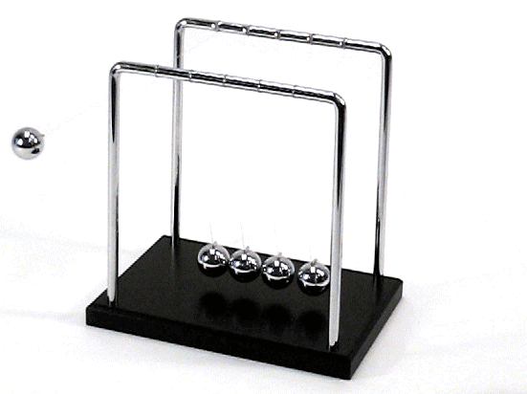
| Objects Should Transfer Energy

Slide 5

| Objects Should Move Correctly

Slide 6

| Objects Should Stay Correctly
Calculations should be very accurate to stay still!
Erin Catto, Allen Chou, Kevin Yu

Slide 7

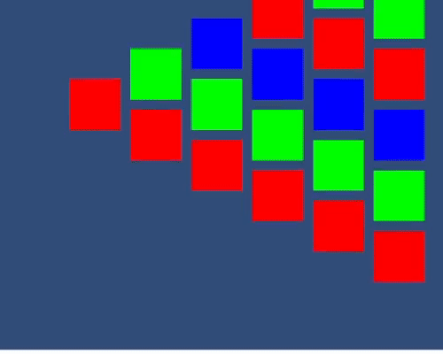
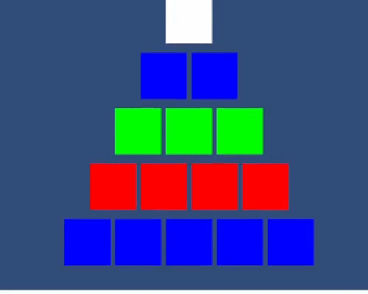
| Let Us Show You Just How Bad ECS Physics Is
Things you can't build
in ECS built-in physics:
Newton's Cradle
Tower
Pyramid

Slide 8
| Our Physics Engine Is Not Just Good, It Is Better
Demo time!

Slide 9
| AI Goals
Robust and Expandable Framework
AI Movement Behaviors
PERFORMANCE!!!

Slide 10
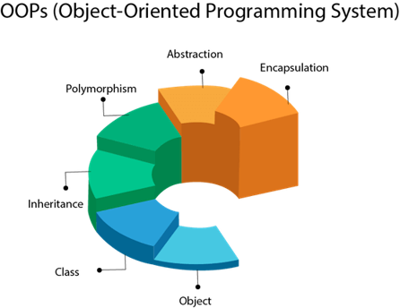
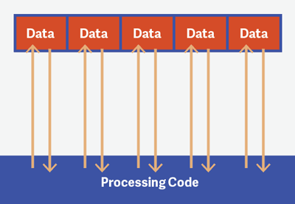
| Getting The Best of Both Worlds
Object Oriented Programming
Data Oriented Programming
Abstraction of ideas
Organization of code
Linear layout of data
Performance

Slide 11
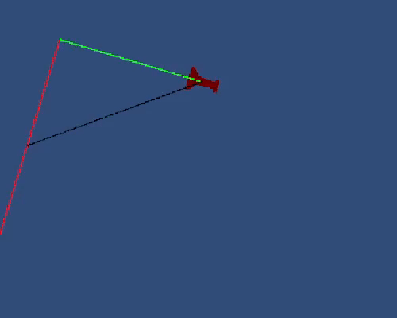


| Enemies can Seek, Wander, and Tether
Seek
Wander
Tether

Slide 12

| Performance Demo

Slide 13
| Risks and Mitigations
Unity ECS has poor documentation
Communicate with David
Look at ECS's siblings
Physics engine is not performant
Algorithmic improvements (broad phase, sleeping etc.)
Tighter coupling with ECS
AI does not have much to show
Demonstrate backend capabilities with performance test
Demonstrate expandability by adding a variety of AI behaviors

Slide 14
| Findings and Conclusion

Slide 15

Thank You!

